Slide 1
Machine Learning CA2
Timothy Ng Tik Ti P7362270

Slide 2
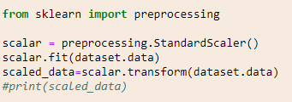
Unsupervised Learning (K-means) – Data Exploration and Engineering
Used print on the loaded dataset to figure out the structure of the data
After which, we performed feature scaling to prevent larger features from dominating others during the modelling (eg. Sepal length vs petal width)
Fig 1: Code for Feature Scaling using sklearn

Slide 3
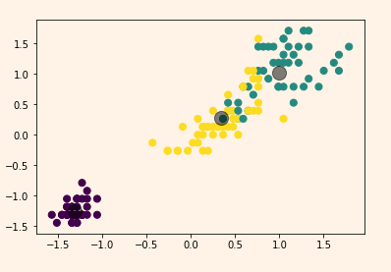
Unsupervised Learning (K-means) – Model Fitting and Visualization
Fitted model to 3 centroid centres and visualized the result using matplotlib
The results seem fine, however as there is overlap in between the yellow and green species
Fig 2: Scatter Plot showing the predicted classification

Slide 4

Unsupervised Learning (K-means) – Model Evaluation
We utilized silhouette score to determine which k is the most suitable
As the silhouette coefficient is the highest at k = 2, as such it is the best value of k for kmeans clustering method of iris dataset. However, as we have prior knowledge, the best k should be 3, but in this case our data is better separated with 2 clusters unfortunately
Fig 3: Silhouette scores for k values from 2 to 5

Slide 5


Unsupervised Learning (Gaussian Mixture Modelling) – Model Evaluation
We utilized Gaussian Mixture Modelling as well with similar steps for our dataset
The silhouette scores are similar as 2 clusters still provided the best silhouette score, so both models aren’t too accurate in classifying
However, in between the two model, Gaussian Mixture Modelling performed better with higher adjusted_rand_score, showing closer fit with our target labels
Fig 4: Silhouette score of Gaussian Mixture Modelling
Fig 5: Score of K-means vs GMM

Slide 6
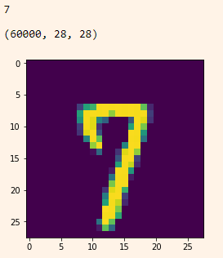
Deep Learning (CNN) – Data Exploration and Engineering
Imported the MNIST data, and explored the data using plot
After which, we reshaped the training and test greyscale data so it can be processed by Keras API, and subsequently normalized the data from 0-255 to 0-1
Fig 6: Plot of a random image and tallied with label

Slide 7
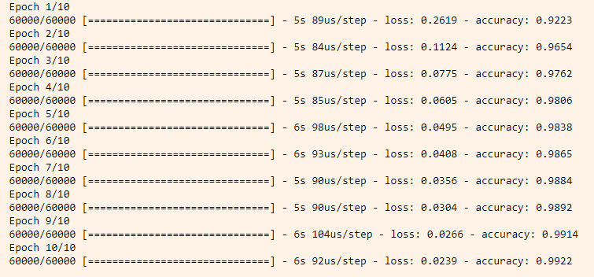
Deep Learning (CNN) – Model Fitting
We selected Convolutional Neural Network as its used for image processing primarily
Used a flatten layer to 1D array, and 2 fully connected layers with 128 neurons. Relu activation function was used
Dropout layer was used to prevent overfitting, and then 10 neurons with softmax function to output probability of each class if needed
The model is trained with ADAM optimizer and trained with accuracy metric over 10 epochs
Fig 7: Model have 0.9922 accuracy after 10 epochs

Slide 8
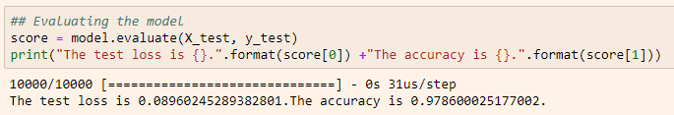
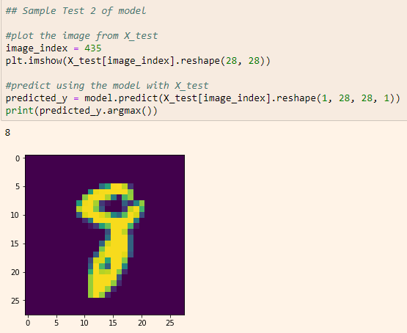
Deep Learning (CNN) – Model Evaluation
The model is evaluated using model.evaluate and the test data, and the accuracy is 0.97, which is decent. Subsequently we tested the model with random X_test values
Fig 8: Code for evaluating loss and accuracy
Fig 9: Testing model with random X_test values

